Slide 1


Slide 2
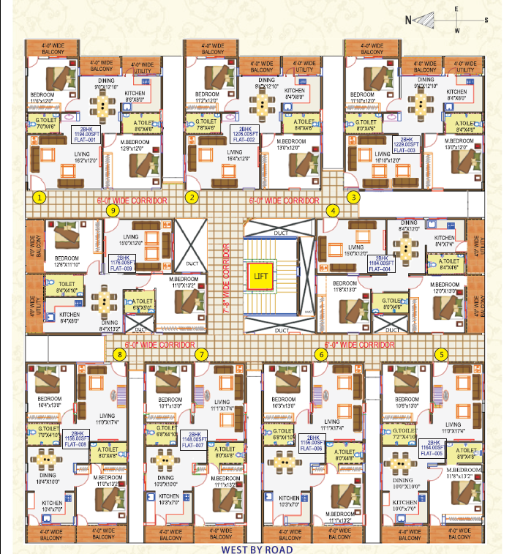

Slide 3
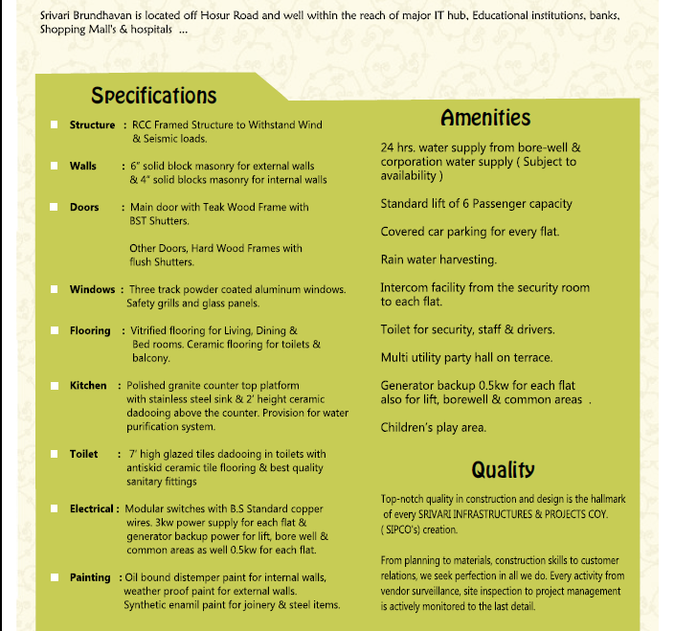

Slide 4
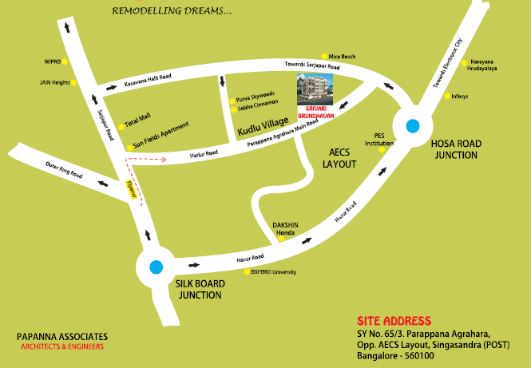

Slide 5


Keshava
9916485861
keshava.venetion@gmail.com
Venetion Group

